Slide 1
Docker Intro

Slide 2
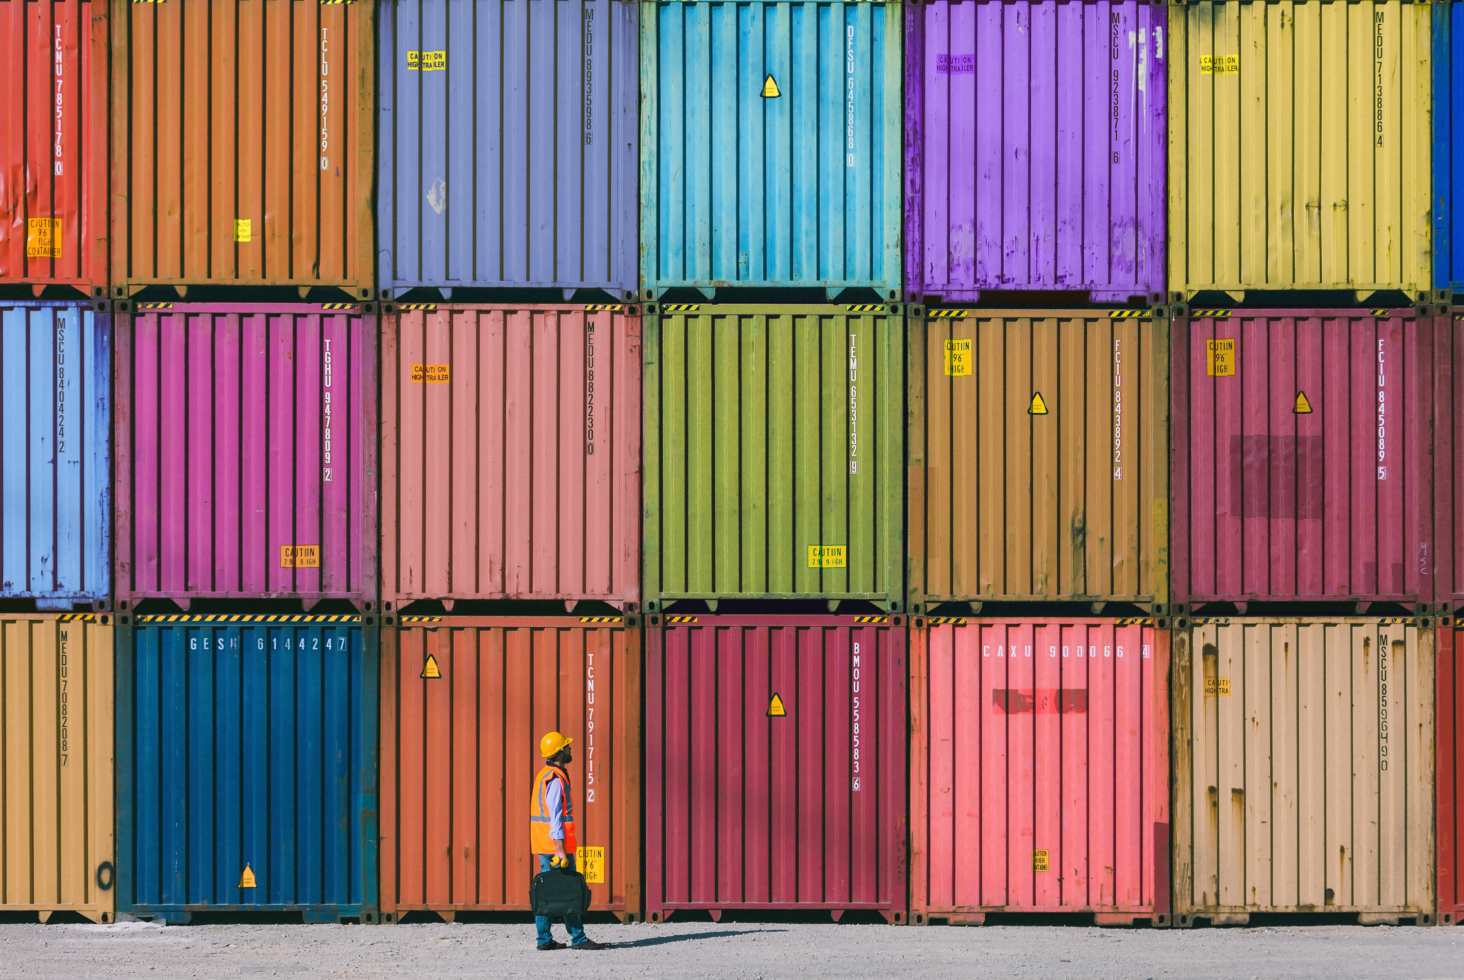
Containers
Used to transport code in a specific environment.
Lightweight alternative to VMs
Less computing power on unnecessary processes.

Slide 3
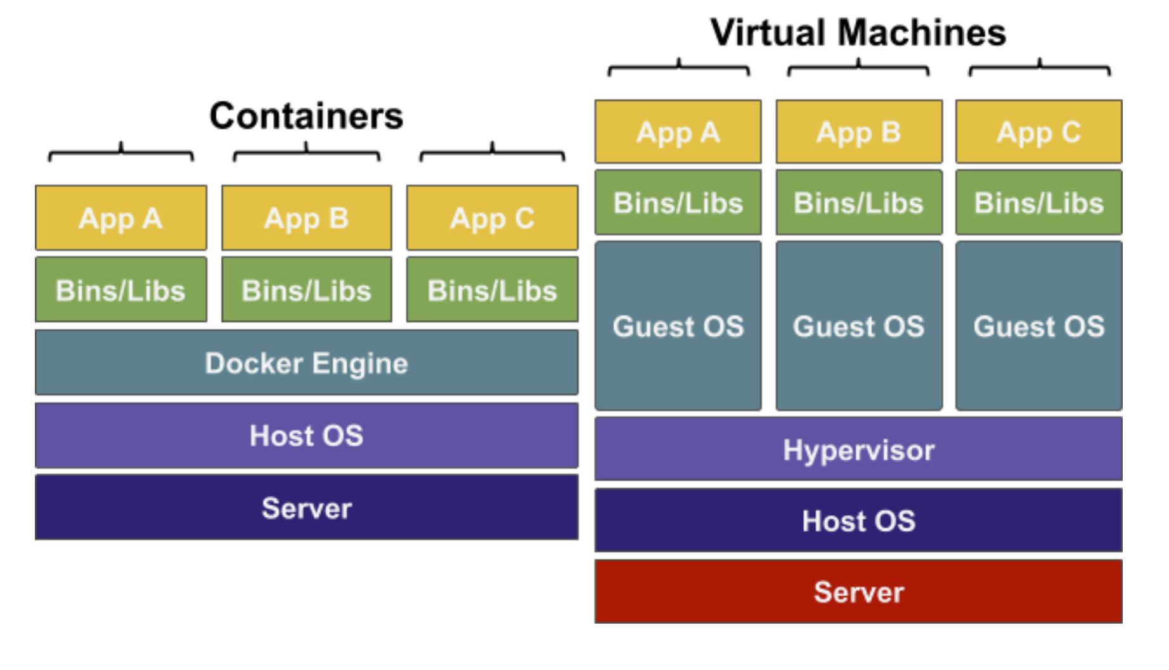
Containers vs Virtual Machines
Server – Physical hardware for the processing power
Host OS – Operating system on the server
Hypervisor – Installed in the Host OS, software to create VMs
Guest OS – Operating system used by the customer
Bins/Libs – Program files for the app to run
App – The app to run
Docker Engine – Containerisation Software on Guest OS

Slide 4
Why developers use containers over VMs
Containers:
Use the same kernel (the core of OS) as the host
Resources are shared between containers if possible
Extremely fast start-up time
Virtual machines:
VMs emulate an entire computer to support an OS
There is complete separation between machines
Far more resources are used to isolate the hosted app
Containers
Vs
vms

Slide 5
Open-source containerisation tool, Well known in the DevOps and Sys Admin space.
Let you configure and replicate environments so you can focus on the code.
Require less computing power as you do not need a guest OS on each container.
Docker can be installed easily with a remote script hosted on https://get.docker.com or can be installed directly on Windows or Mac.
What is Docker?

Slide 6
Docker Images

Slide 7


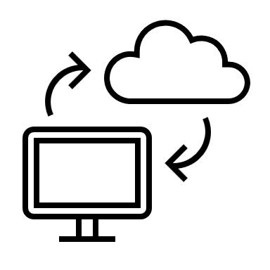
Is a read-only file
A snapshot of the state of a system at a particular point in time
It is like taking an image of your PC. You can then move it to another PC
Docker Image

Slide 8
Image Layers
Images are composed of multiple layers
Layers are read only. To change a layer, create a new one and add it to image
Start with a simple image and add new layers to create new images.
Each Dockerfile instruction creates a new layer.
Layers are cached, so changing a line in Dockerfile rebuilds only the layer affected by that change
nginx
nginx code
Other stuff
ubuntu
FROM alpine:3.4
RUN apk update
RUN apk add vim
RUN apk add curl

Slide 9
Registry - DockerHub
Images are typically stored in remote registries
Can be used by other people for their CI/CD
Docker Hub is the default image registry https://hub.docker.com/
The Docker CLI works with Docker Hub Login with docker login

Slide 10
Docker Containers

Slide 11
Containers are what our images run in They run in the same way across any device with Docker.
Containers have the following info:
- Container ID - Image - Command - Created - Status - Ports - Names
Containers

Slide 12

Containers in CI
Containers allow you to simultaneously run your codebase in a repeatable environment.
Containers run the same in any machine, Can replicate part of the production environment.
Saves time and human error
Integration Test Environment
Code base
CoolApp:1.2
Credentials + environment
CI Server
Version Control System
Unit Test Environment
Docker
CoolApp:1.2
Credentials + environment

Slide 13
When running our application inside a container, its important to be able to interact with them individually and collectively.
There are limited commands to running and managing a number of containers. Container orchestration tools such as Kubernetes make this job easier.
A few container commands
Command | Function
ps ps -a | Lists all running containers -a shows all containers, running or not
logs | Returns logs of the container
exec | Connect to an individual terminal via a shell
start | Starts a stopped containers (Run creates and starts container)
stop | Stops a running container
rm (-f) | Deletes a container (-f forces it to be removed)
rename | Renames a container

Slide 14
Lab
Please do the lab
1-Docker basics.docx

